Slide 1
SAI and Tuition Promise
Charles Mayfield
Director of Financial Assistance
Northwest Missouri State University

Slide 2
Northwest Missouri State University
Institutional Summary
4-year public located in Maryville, MO
Enrollment of ~10,000
~6,000 undergraduate students
~4,000 graduate students
In state COA ~$27,000
Tuition and fees ~$12,700
Out of state COA ~$35,000
Tuition and fees ~$20,800

Slide 3
Northwest Missouri State University
Institutional Summary
35% of Freshmen are Pell Grant-eligible
32% of Undergraduates are Pell Grant-eligible
Net Price - Overall ~$14,000
By income band
$0-$30,000 ~$10,900
$30,001-$48,000 ~$10,800
$48,001-$75,000 ~$12,000
$75,001-$110,000 ~$15,800
$110,001 + ~$17,900

Slide 4
NASFAA SAI Modeling Tool Results
All Undergraduate students with a FAFSA on file
Average Median Pell eligible Full Pell-eligible
EFC 21,721 10,822 2,077 873
SAI 21,998 8,944 2,628 1,587
Zero EFC 881 students
<= zero SAI 1,587 students
SAI >= EFC 1,491 students
SAI < EFC 4,039 students
*median Pell award using SAI matched max Pell award for all groups evaluated

Slide 5
NASFAA SAI Modeling Tool Results
All Undergraduate students with a FAFSA on file
EFC
2,077 Pell Grant-eligible students
~$11M received
SAI
2,628 Pell Grant-eligible students (~25% increase)
$14.5M received (~30% increase)
*median Pell award using SAI matched max Pell award for all groups evaluated

Slide 6
NASFAA SAI Modeling Tool Results
First time Freshmen students with a FAFSA on file
Average Median Pell eligible Full Pell-eligible
EFC 21,052 9,081 1,002 461
SAI 20,470 6,633 1,256 769
Zero EFC 578 students
<= zero SAI 996 students
SAI >= EFC 696 students
SAI < EFC 2,361 students

Slide 7
NASFAA SAI Modeling Tool Results
First time Freshmen students with a FAFSA on file
EFC
1,002 Pell Grant-eligible students
~$5.4M awarded
SAI
1,256 Pell Grant-eligible students (~20% increase)
~$7M received (~29% increase)

Slide 8
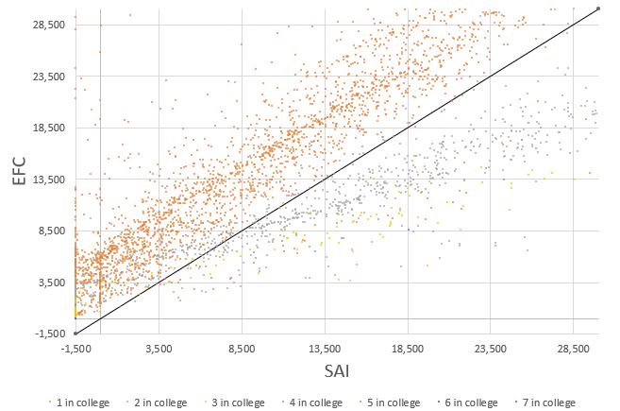
Number in college impact

Slide 9
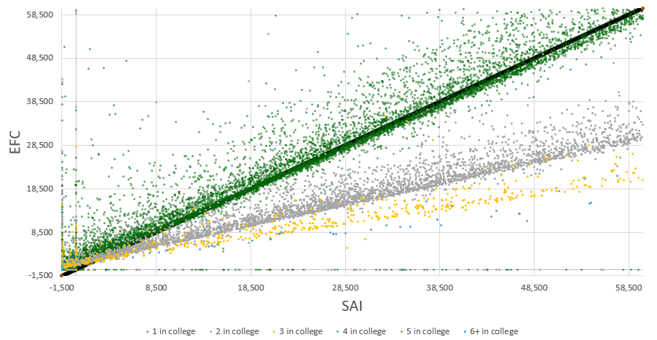
# in college cont… another 4yr public ~40K undergrads

Slide 10
Northwest Promise Grant
Origin ~2002, with several iterations over the years
Incoming Freshmen are evaluated, cohort concept
Pell Grant eligible or family income <= $65,000
In state
18 ACT and 2.5+ HS GPA or
2.75+ HS GPA
Out of state
Pay in state tuition using Bearcat Advantage tuition waiver
Sliding scale eligibility through 2023-24
2.75+ HS GPA beginning with 2024-25
Fills gap between the cost of tuition and standard fees minus all federal, state, and institutional funds
Initial calculation is for 15 credits/term, increase for 16+ hours, don’t adjust down

Slide 11
Northwest Promise Grant
Renewal requirements
Remain Pell Grant eligible or family income <= $65,000
In state
2.0 cumulative Northwest GPA
24 Northwest hours earned in academic year
12 NW hours earned if spring start
Out of state
Remain eligible to pay in-state tuition rate
3.0 cumulative Northwest GPA
24 Northwest hours earned in academic year
4-year renewal

Slide 12
NASFAA SAI Modeling Tool Results
Continuing Northwest Promise students with a FAFSA on file
Average Median
EFC 1,578 728
SAI 298 (1,500)
Zero EFC 117 students
<= zero SAI 227 students
SAI >= EFC 30 students
SAI < EFC 298 students

Slide 13
NASFAA SAI Modeling Tool Results
Continuing Northwest Promise students with a FAFSA on file
EFC
326 Pell Grant-eligible students
~$1.7M received
SAI
321 Pell Grant-eligible students (~2% decrease)
$2M received (~17% increase)

Slide 14
NASFAA SAI Modeling Tool Results
Freshmen Northwest Promise students with a FAFSA on file
Average Median
EFC 1,508 249
SAI 2,547* (1,500)
*one student with EFC 0 and calculated SAI ~1.9 million
Zero EFC 353 students
<= zero SAI 542 students
SAI >= EFC 75 students
SAI < EFC 695 students

Slide 15
NASFAA SAI Modeling Tool Results
Freshmen Northwest Promise students with a FAFSA on file
EFC
766 Pell Grant-eligible students
~$4.1M received
SAI
754 Pell Grant-eligible students (~2% increase)
$4.7M received (~15% increase)

Slide 16
Northwest Promise Grant
What if a student already has tuition and fee covered?
212 of 770 (27%) offered freshmen don’t have a calculated award, 30 hours of tuition/fees already covered.
70 of 302 (23%) enrolled freshmen don’t have a calculated Promise award.
81 of 314 (26%) enrolled continuing students don’t have a calculated Promise award.

Slide 17
Northwest Promise Grant
Incoming Freshmen
With EFC
Offered $1.55M to 559 students
Average offered award $2,780
Paid $689K to 233 students
Average paid award $2,960
With SAI
Would offer $1.19M to 510 students
Average award $2,340
Paid $532K to 207 students
Average paid award $2,570
Notes:
Estimated savings of $150K

Slide 18
Northwest Promise Grant
Continuing Students
With EFC
Paid $770K to 233 students
Average paid award $3,300
With SAI
Paid $595K to 206 students
Average paid award $2,890
Notes:
Estimated savings $175K

Slide 19
What about those who lose Pell Grant-eligibility?
All undergraduate students
~ 60 students are no longer Pell Grant-eligible
15 freshmen Promise students and would need ~$107 to replace lost Pell and Promise funding
<10 continuing Promise students and would need ~$44K to replace lost Pell and Promise funding
37 students are not Promise-eligible and would need ~96K to replace lost Pell funding
Notes:
~$250K needed to hold harmless, potential for $325K in gross savings, net potential savings $75K.

Slide 20
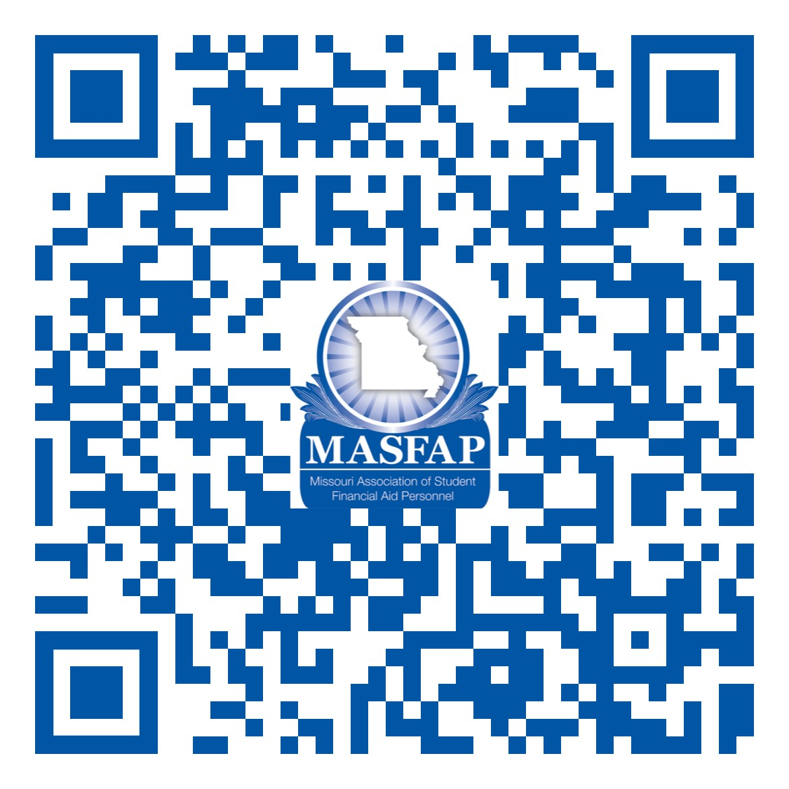
Session Survey
Questions?!?
Charles Mayfield
Director of Financial Assistance
Northwest Missouri State University
660.562.1138, mayfield@nwmissouri.edu

